Slide 1
ILLUSION ("Solar Solutions Web Application")
A React-based Application
Made by: Aliyan Ahmed Cheema Muqadas Imtiaz
Hassan Mahboob

Slide 2

Introduction
Overview:
ILLUSION is a responsive web application built using React
It aims to provide a comprehensive product directory, company information, and user-friendly contact options.
Objectives:
Deliver a seamless user experience.
Ensure scalability and maintainability through modular design.
Technology Stack:
React for frontend development.
Tailwind CSS for styling.
Vite for fast development

Slide 3
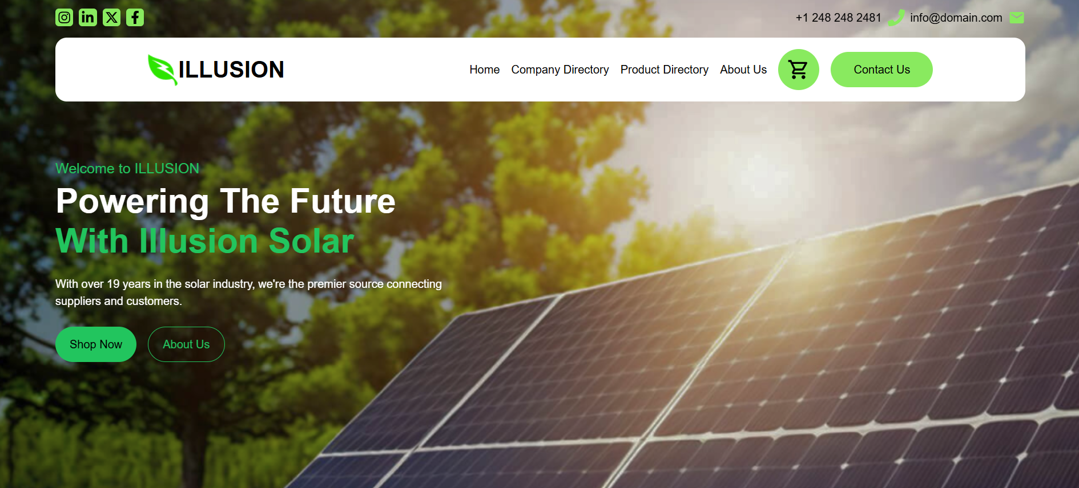
Task Division
Home, Contact Us done by Muqadas Imtiaz
Product Directory, Cart done by Hassan Mahboob
Company Directory, About us done by Aliyan

Slide 4
Features of the Application
Product Directory:
Organized display of various products.
Company Listings:
Information about relevant companies.
Contact Form:
Easy communication with the platform.
Solar Solutions:
Dedicated section for solar-related offerings.
Testimonials and Reviews:
User feedback and ratings.

Slide 5
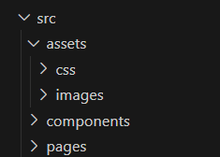
Application Directory Structure
Key Directories:
src/components/: Reusable UI elements.
src/pages/: Main application pages.
src/assets/: Static files like images and fonts.
src/routes/: Configuration for React Router.
src/styles/: Tailwind CSS customization.

Slide 6
Why React Framework?
Reasons for Choosing React:
Component-based architecture for reusability and scalability.
Virtual DOM for efficient updates.
Ecosystem of tools and libraries.
Strong community support.
Simplifies complex UI development compared to vanilla JavaScript.

Slide 7
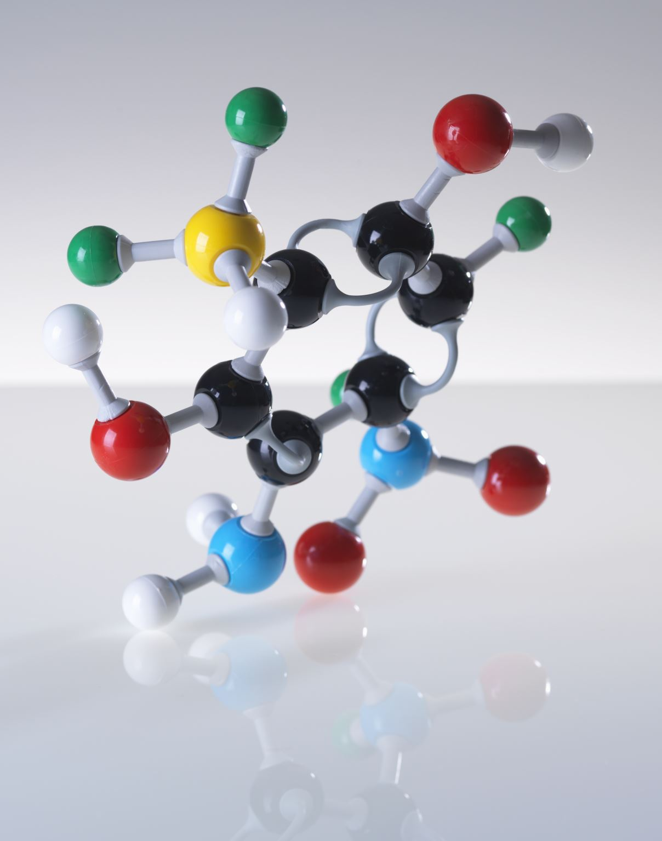
React Concepts Used
Core Concepts:
Props: Passing data between components.
States: Managing dynamic data within components.
React Hooks:
useState: For state management.
useEffect: For side effects like fetching data.
Why Chosen:
Simplifies functional component behavior.

Slide 8
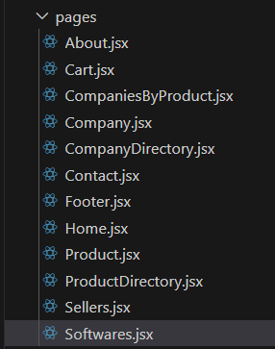
Routes and Pages
Routes' Structure:
Defined using React Router for seamless navigation.
Example Routes:
/: Home Page
/products: Product Directory
/contact: Contact Us
Summary:
Total Components: 15
Total Routes: 5
Total Pages: 12

Slide 9
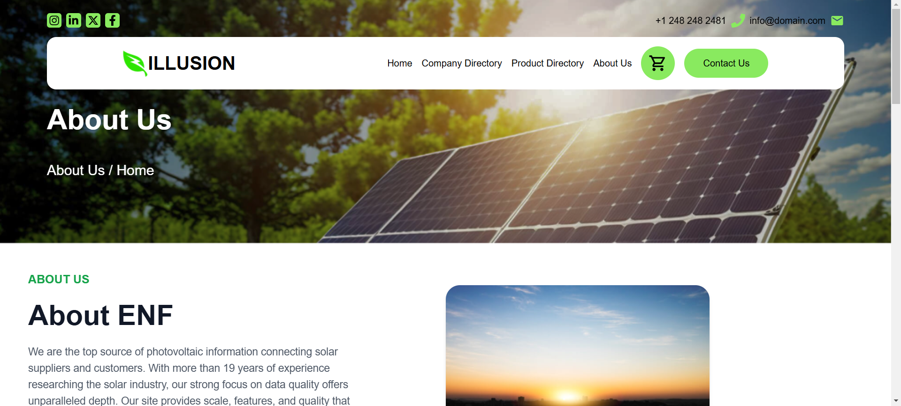
Core Pages
Home:
Introduces the platform’s primary offerings.
About:
Shares company mission and values.
Product Directory:
Comprehensive list of products.
Contact Us:
Enables user inquiries.
Cart:
Allows users to save and manage selected products.

Slide 10
Application Architecture
High-Level Structure:
Components-based architecture for reusability.
Organized directory structure:
src/components/ for UI elements.
src/pages/ for primary routes.
Technologies Used:
Tailwind CSS for utility-first styling.
Vite for efficient bundling and development.

Slide 11

Key Components
NavBar:
Ensures intuitive navigation.
HomeBanner:
Highlights the most important offerings.
ProductDirectory:
Displays a categorized list of products.
ContactForm:
Facilitates user interaction with the platform.

Slide 12
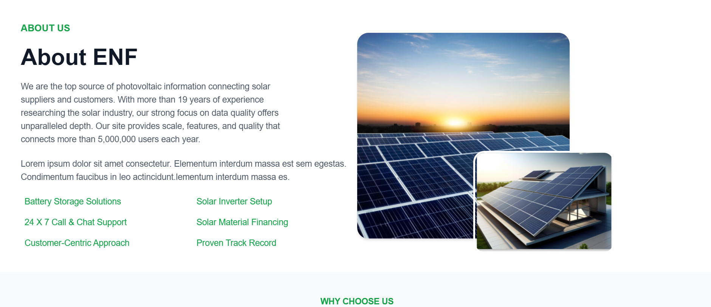
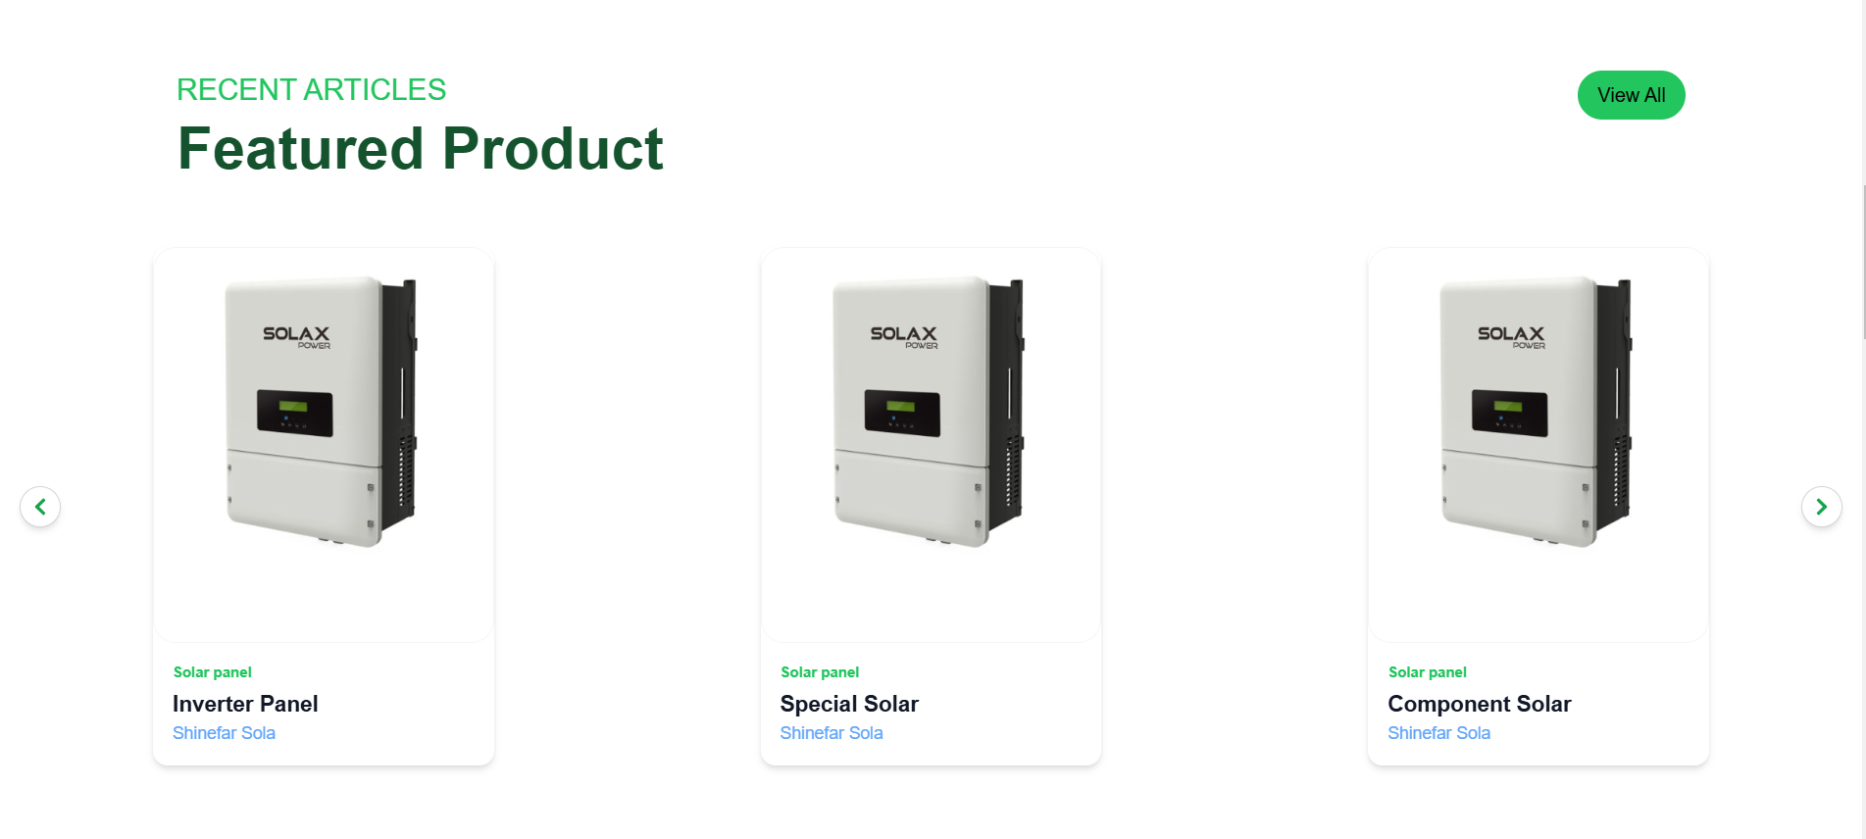
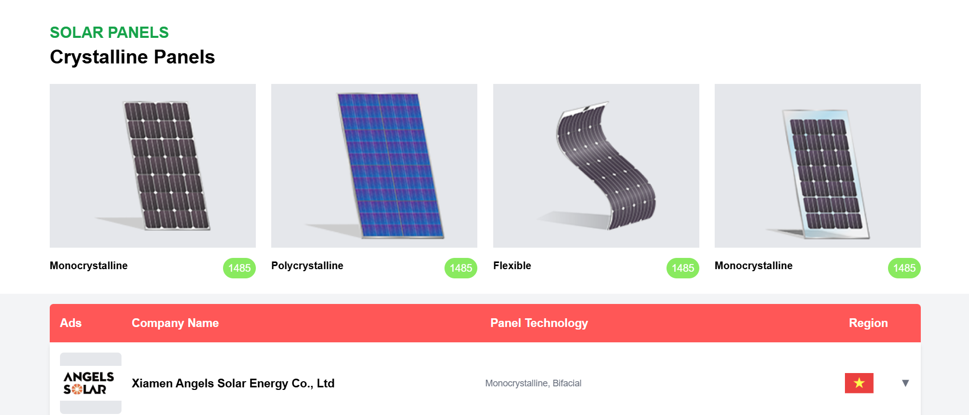
Design and Styling
Tailwind CSS:
Simplifies styling with utility classes.
Ensures a responsive layout.
Consistent Theme:
Cohesive color schemes and typography.

Slide 13
Project Workflow
Data Flow:
Utilizes React props for data sharing.
Component Interaction:
Clear hierarchy and modular design.
Routing:
React Router for navigation between pages.

Slide 14

Interesting Features
Highlighting Unique Aspects:
Responsive design with Tailwind CSS.
Dynamic product listings and filtering.
User-friendly contact form.

Slide 15

Challenges and Solutions
Were We Stuck?
Yes
During state management for dynamic data.
To many rerenders
Animation on Scroll handling
TailWind CSS required an initial learning curve
Solution:
Leveraged React hooks like useState and external resources for guidance.
Used the “UseEffect” React hook.
Read documentations for better understanding.
Understood Tailwinds functionality and implemented it.

Slide 16

Demonstration

Slide 17
Conclusion
Summary:
The ILLUSION project demonstrates effective use of React.
It provides a robust foundation for scalable web applications.
Key Takeaways:
Importance of modular design.
Efficient development through modern tools.

Slide 18
THE END!

